Slide 1

CAG 5
By : Glendys

Slide 2

The Problem Faced by People that I Have Chosen to Address
Enhancing Financial Inclusion through FinTech
Addressing the Needs of the Unbanked and Underbanked

Slide 3

Why I have Chosen this Problem
I feel that many people get scammed due to their lack of knowledge and access in banking matters and therefore want to suggest how to solve it to the best of my ability.
Especially in terms of
Lack of Access to Financial Services
Limited Opportunities for Financial Growth
Vulnerability to Cash Transactions

Slide 4

What I want to Do to Combat this Problem
My Business Plan is to create a business that focuses on spreading awareness of scams and Educating people on Banking Matters (What it is, its use, and how it can help them) specifically in Urban Places and Undeveloped Countries that have little to no access to it

Slide 5
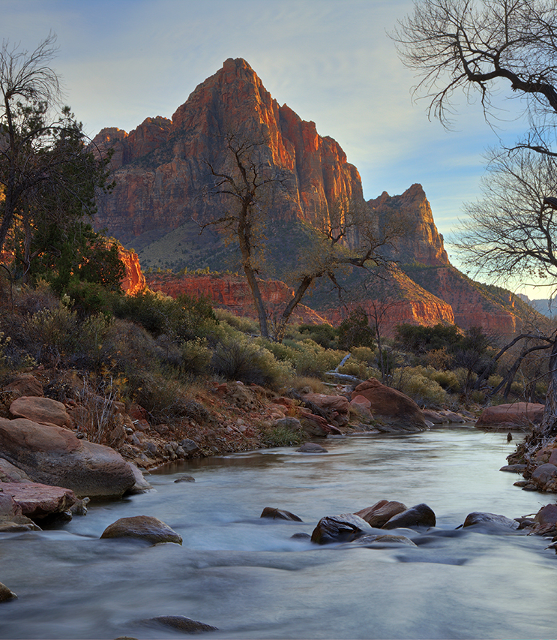
Why do I want to Spread Awareness about Scams, Proper Accounting Methods of their Money, and Banking Matters?
I feel that many people from undeveloped countries and rural places, do not have access to proper banking, and to add on, are unaware of accounting methods and scams, leading to them losing their hard-earned money.
Most of them do not have access to technology or banking services where they live, and those who find jobs overseas, are trapped through things like recruitment fees, remittance tax, or even just being shortchanged by their employers.
This leads them to lose rather large amounts of the already meager amounts they earn, which is meant for their family's survival.

Slide 6

Final Goal of my Business?​
The final goal of my business, is for finance and banking to be available to anyone and everyone, and to decrease the rate of people falling for scams.
I plan to achieve my goal through various methods
Teaching about banking and financial methods
Ways to avoid scams
Interest and motivate others to work towards the same goal
Make it a success <3

Slide 7

Step by Step ways I plan to Achieve my Goals
Step 1 :
Create a business and promote it, to find others who share similar sentiments as me.
Step 2 :
Find sourcing for money to fund our traveling expenses and the items we need to spread awareness on scams, financial matters, and banking matters.
Step 3 :
Alias with a non-profit organization, to help aid us during our trips. For help in finding places to settle in, where to find food, introduce us to the people, e.g.

Slide 8

Relevant MAS Regulations and Sources
Regulations
Payment Services Act (PSA)
Financial Advisers Act (FAA)
AML/CFT Regulations
Sources
World Bank
Deloitte
Monetary Authority of Singapore

Slide 9

Thank you

